Slide 1
Clear goals and minimizing barriers in the curriculum
Katelyn Casperson
George Washington University

Slide 2
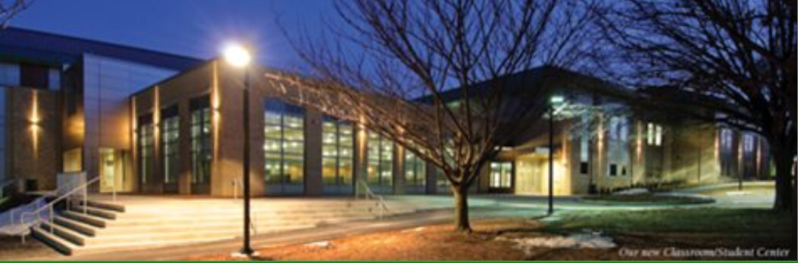
My Curriculum
I’m teaching a Self Determination and Self Esteem course for adults with disabilities at Frederick Community College.
I’ve been given complete creative freedom to create my curriculum.
Frederick Community College
Photo retrieved from https://www.frederick.edu

Slide 3
My Curriculum
The course is once a week for 4 weeks, so I decided to devote each class to a topic.
Week 1-Goal Setting- Students will demonstrate understanding of the S.M.A.R.T goal setting by creating their own goal that aligns with the S.M.A.R.T criteria. Students will create vision boards that correspond with their stated goals.
Week 2-Self Determination-Students will explore the meaning of self-determination through PowerPoint presentation and social story videos. Students will complete a self-determination assessment and determine the areas of self-determination they need to work towards.
Week 3-Self Advocacy-Students will explore the meaning of self advocacy through Powerpoint presentation and social story videos. Students will exhibit understanding of self advocacy through role playing exercises.
Week 4-Problem Solving-Students will practice problem solving by incorporating previous understanding of self-determination and self-advocacy into guided questions, role playing exercises, and responding to social story videos.

Slide 4

Incorporating Flexibility
I try incorporate flexibility and variability by giving students choices within each lesson.
For example:
Choice of group work or individual work
Flexible seating
Listen, read, and/or record lessons
Allowing students to approach the material with their own interests and experiences in mind.
“Because each learner brings unique experiences and backgrounds to each situation, offering even two options can help the nervous system appraise the situation in a more positive way” (Posey,2019)
Photo retrieved from https://dreamstime.com

Slide 5
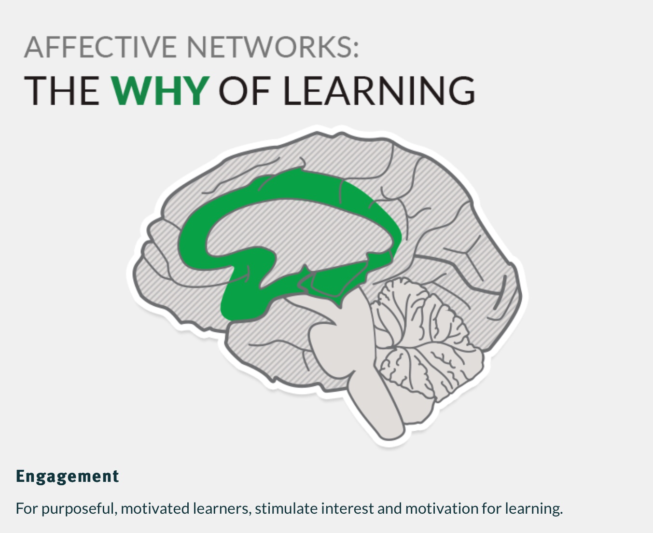
Implementing UDL-Affective Networks/Engagement
In the first class, students were asked to create a name tag encompassing their interests and strengths through drawings and/or words.
This was used to introduce the overarching principle of self determination.
Image retrieved from https://www.cast.org

Slide 6
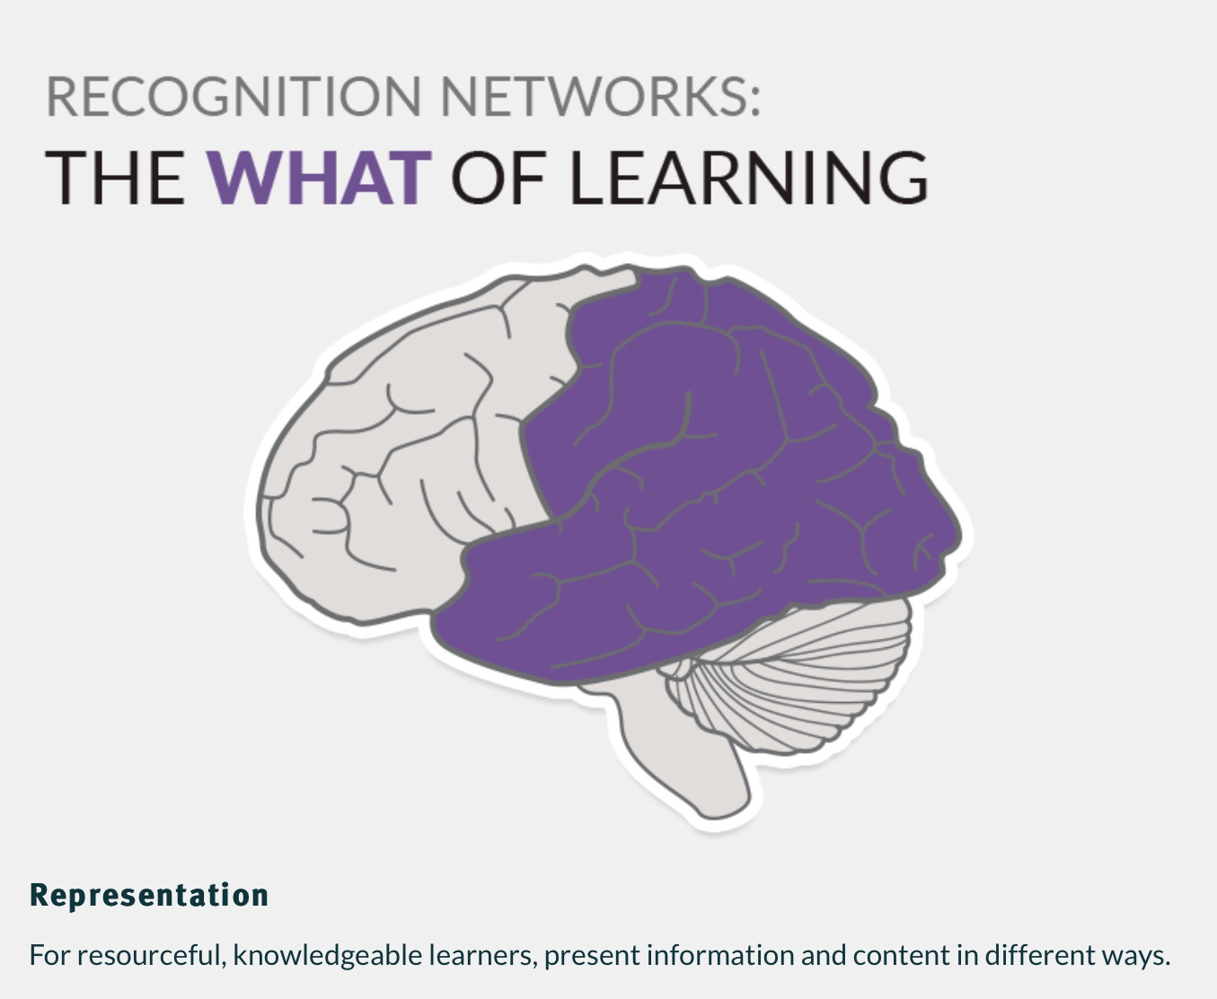
Implementing UDL: Recognition Networks/Representation
In the first class, the main focus areas were written on the board.
As I explained what each term meant, I also wrote the definition next to the corresponding term.
Students were given the option to take notes, take a picture with their phone, use an audio recording device, or receive a copy of the list to support their clarification of the vocabulary.
Image retrieved from https://cast.org

Slide 7
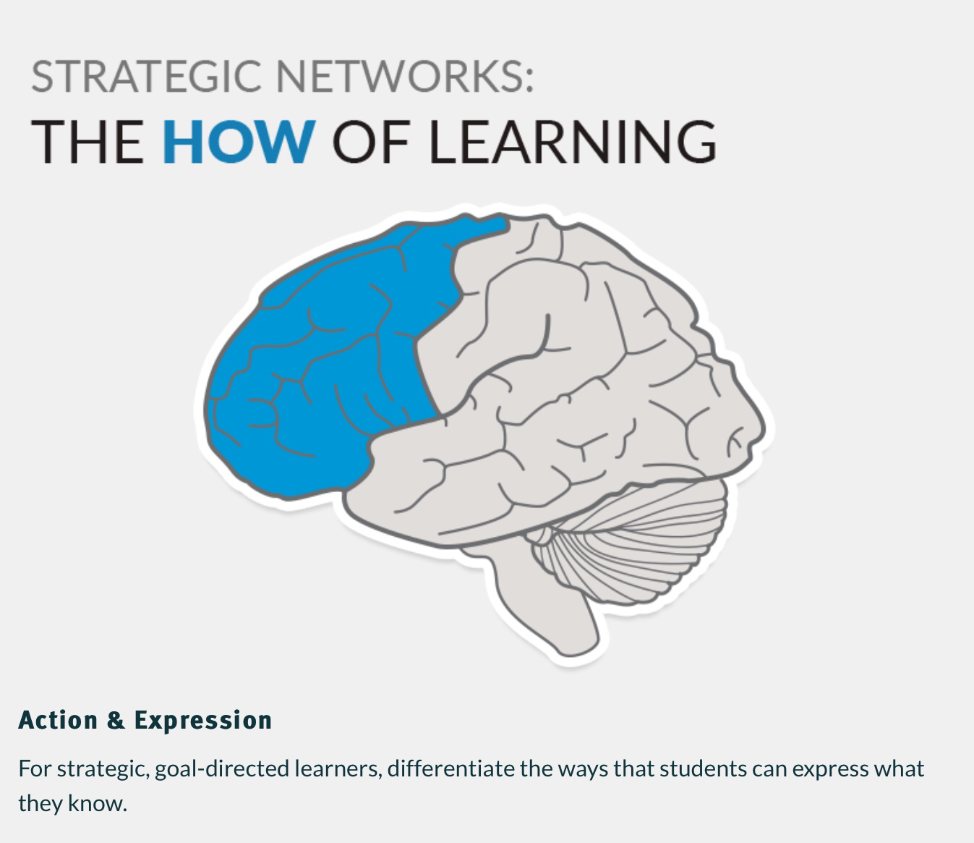
Implementing UDL-Strategic Networks/Action & Expression
After reviewing S.M.A.R.T goals, students were instructed to create their own goal that aligns with the same standards.
Students were given the choice to write, orally express, and/or create a vision board to exhibit their goal.
This allowed students to choose how they wanted to demonstrate that they understood the principles of S.M.A.R.T goals.
Image retrieved from https://cast.org

Slide 8
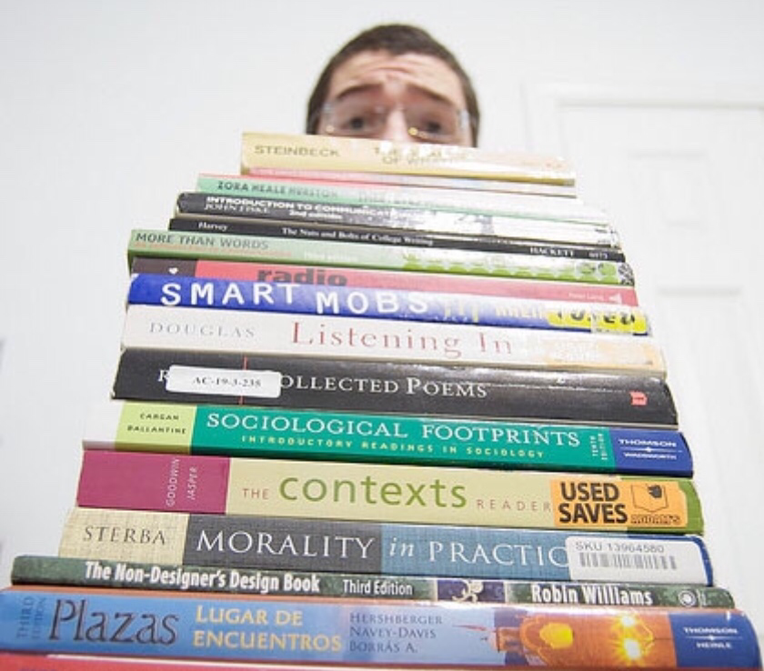
Barriers with Traditional Classroom Materials
It’s common for students to be assigned the same task and to complete it the same way (e.g., reading a chapter in a textbook and answering questions on a worksheet).
Utilizing textbooks in general can be a limiting way for students to receive information, especially if reading is not a strong suit for students. It presents the information in a very one dimensional way.
“When we have students do the same task in the same way and at this same time, we are not designing for the range of students we know we have” (Posey, 2019).
“Working under the false assumption that learners can be categorized as typical or atypical, educators have historically developed lessons that address the so-called average learner” (Ralabate, 2016).
Image retrieved from http://www.kqed.org

Slide 9
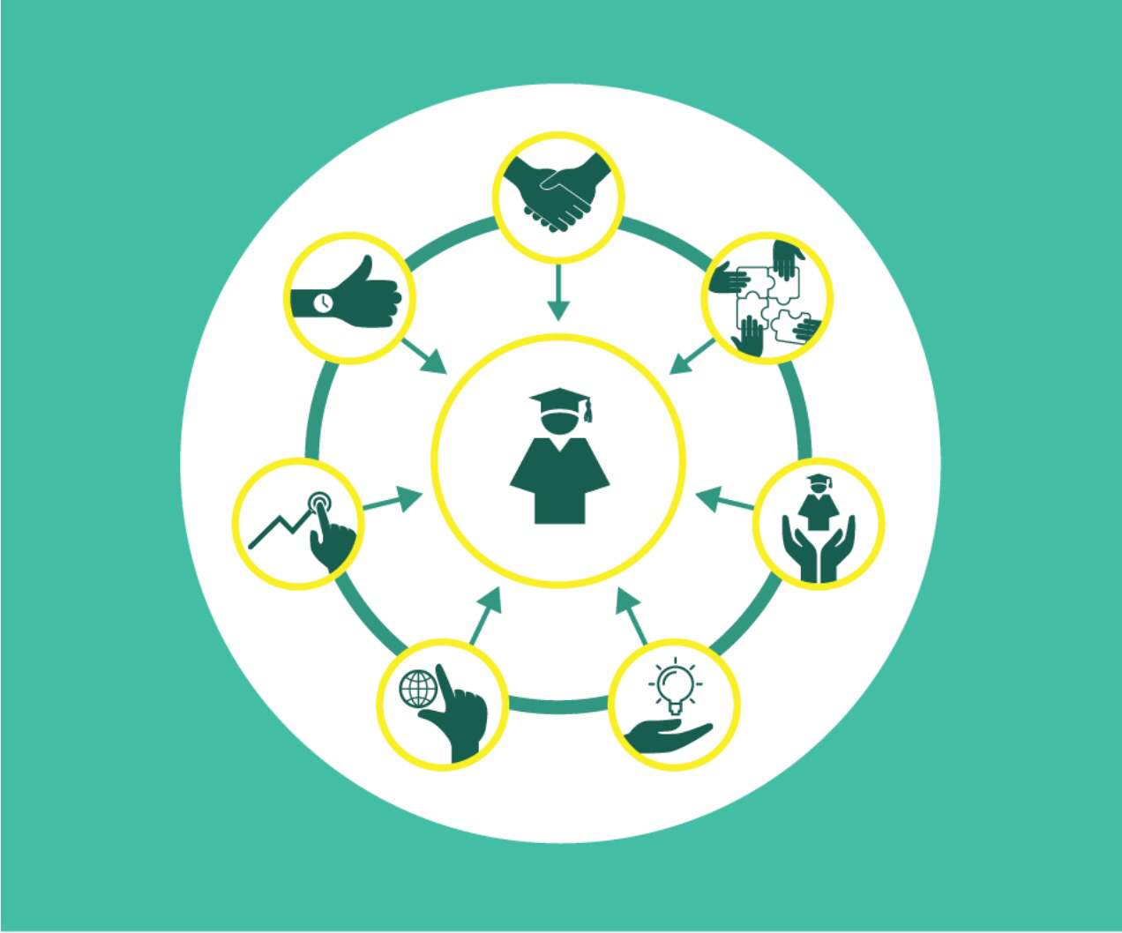
Student Centered Curricula
“Every learner in a classroom will appraise and feel each situation differently based on the goals, the context, and the individual’s previous experiences” (Posey, 2019).
With this in mind, it’s important to utilize flexible technologies and utilize UDL to help students succeed.
Teachers can provide various means for the students to learn the material, including
Different ways of customizing display of information (whiteboard, computer screen, printed page, tactile graphics etc…)
Alternatives for auditory information (voice recognition, music/sound, teacher lecture etc..)
Image retrieved from https://educationevolving.org

Slide 10

Benefit of Technology in Curriculum Materials to Facilitate Student Centered Learning
The use of technology in curriculum has been a game changer, especially for reaching learners in more ways.
“Access to the Internet and digital-technology tools can make available a plethora of options for engaging learners and representing content as well as numerous applications learners can use to show what they’re learning” (Ralabate, 2016).
Technology also tends to be more engaging and interactive than traditional instructional methods such as textbooks and lectures.
Image retrieved from https://gograph.com

Slide 11

Goal Driven Methods
Every lesson should be approached with the initial thought, “why does this matter” or “what is the end goal”.
Not only does setting a goal define the desired outcome, but it also initiates engagement in the material at hand.
“Because emotions are at the core of the brain’s appraisals, connecting the goals to authentic and relevant experiences will help students activate their physiology and appraise the situation positively”(Posey, 2019).
Image retrieved from https://clip art-library.com

Slide 12
How I’ve Implemented Goal Driven Methods Thus Far
In the first class, I took the time to share the learning outcomes and goals of the course. I wrote on the white board and explained the meaning of each learning outcome and explained how exploring each outcome would connect to the students’ life. I also gave the students an opportunity to share how they interpreted the learning outcomes and how they were relatable to their lives.
“The first step in engaging your learners as self-directed learners is sharing the learning goals with them. You can do this by posting the learning goals in you classroom or learning environment, reviewing the goals at the beginning of the lesson, asking students to restate the learning goal in their own words, asking the students to check on their own progress during the lesson, and reviewing the learning goals at the end of the lesson as part of the lesson summary” (Ralabate, 2016).

Slide 13
How I’ve Implemented Goal Driven Methods Thus Far Continued…
The first activity I had my students do was to review the S.M.A.R.T goal design and apply it in creating their own personal goals.
I did this for a couple of reasons. First, I wanted students to be comfortable approaching material with a goal oriented mindset. Second, I wanted the students to have something in mind that motivated them, as well as something they could relate all the learning outcomes back to.
I also had students create a vision board to express their goal in the form of a collage to serve as a visual reminder of what they’re working towards.

Slide 14
References
Ralabate, P. (2016). Your UDL Lesson Planner: The Step-by-Step Guide For Teaching All Learners. Maryland: Brookes Publishing.
Posey, A. (2019). Engage The Brain: How to Design for Learning That Taps into the Power of Emotion. Alexandria, VA, USA: ASCD.

